Slide 2
File Handling
Introduction
Data files
Opening and closing files
Working with text files
Standard Input,Output and Error Streams
Working with Binary Files
Working with CSV Files

Slide 3
File Handling
What is file??
A file in itself is a bunch of bytes stored on some storage device like hard disk.
It help in storing information permanently.
Every programming language offers some provision to use and create files through programs.
There are two types of files:
They are
Text files
Binary files

Slide 4
Contd...
What is text file?
There is normal text file for eg:notepad file
There is no convertion (human to machine language)
Data which store directly.
Basically when we open the file it will be in readable form
It is slow while comparing to binary file.
What is binary file?
A binary file stores the information in the form of bytes.A binary file contains information in the same format in which the information is held in the memory.
Binary files are faster because it is not in human readable form and easier for a program to read and write than are text files.
It is used to store audio,video and images.

Slide 5
f=open(“text.txt”,”r”)
f -> file object or file handle
f=open(“C:\myfolder\text.txt “,”r”)(wrong)
Because in this \text.txt (\t,\n,\r python will consider this as special characters)
f=open(“C:\\myfolder\\text.txt”,”r”)(correct) or
f =open(r”C:\myfolder\text.txt”,”r”)(r denotes a raw data)

Slide 6
Access Modes
r r+
w w+
a a+
Text files
rb rb+
wb wb+
ab ab+
Binary files

Slide 7
Contd….
f=open(“ss.txt”,”r”)
Print(“file name”,f.name)
Print(“file mode”,f.mode)
Print(“Isfilereadable:”,f.readable())
Print(“Isfile closed”,f.closed)
Output:
ss.Txt
r
True
False

Slide 8
Contd…
f=open(“ss.txt”,”r”)
str=f.read()
Print(str)
(Or)
f=open(“ss.txt”,”r”) print(f.read())
f=open(“ss.txt”,”r”) print(f.read())
f.read(3)
ss.txt
A B C D
E F G H
A B C D
E F G H
A B C D
E F G H

Slide 9
Contd…
A B
f=open(“ss.txt”,”r”)
f.read(3) print(f.read(3))
f=open(“ss.txt”,”r”)
s=f.readline()
Print(s)
s=f.readline()
Print(s)
f=open(“ss.txt”,”r”)
s=f.readline()
Print(s,end=“ “)
s=f.readline()
Print(s)
A B C D
E F G
A B C D
E F G

Slide 10
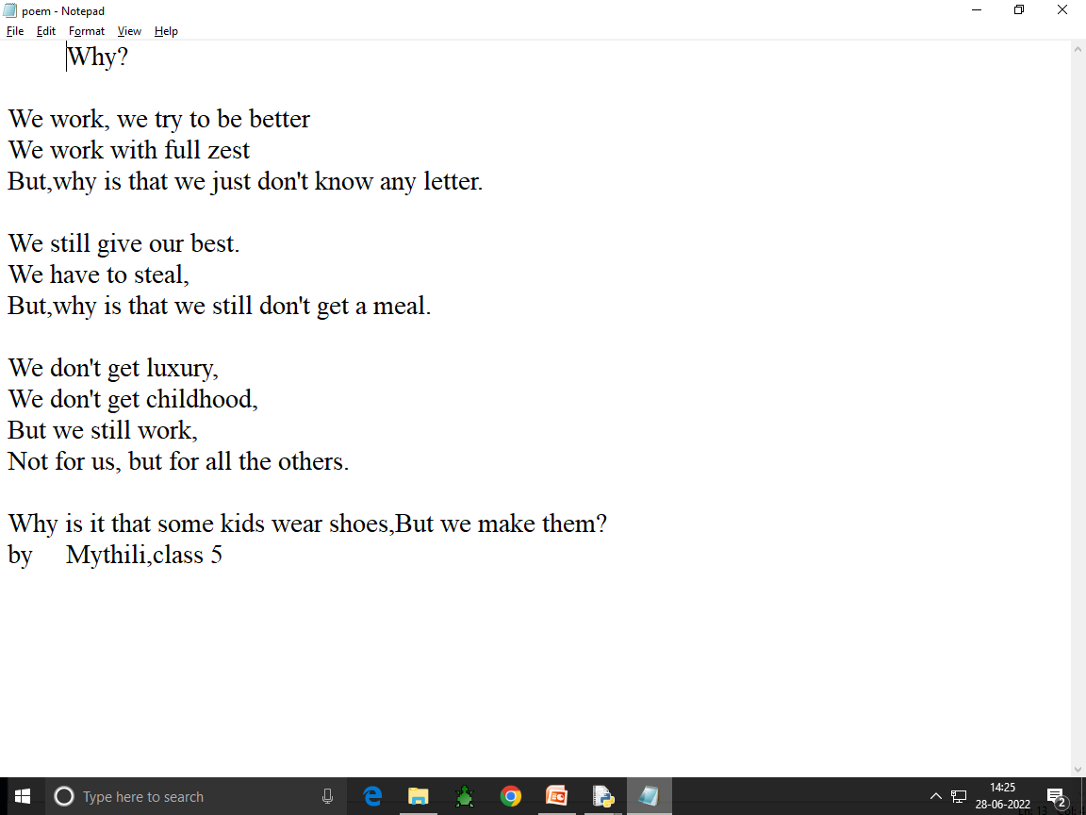

Slide 11
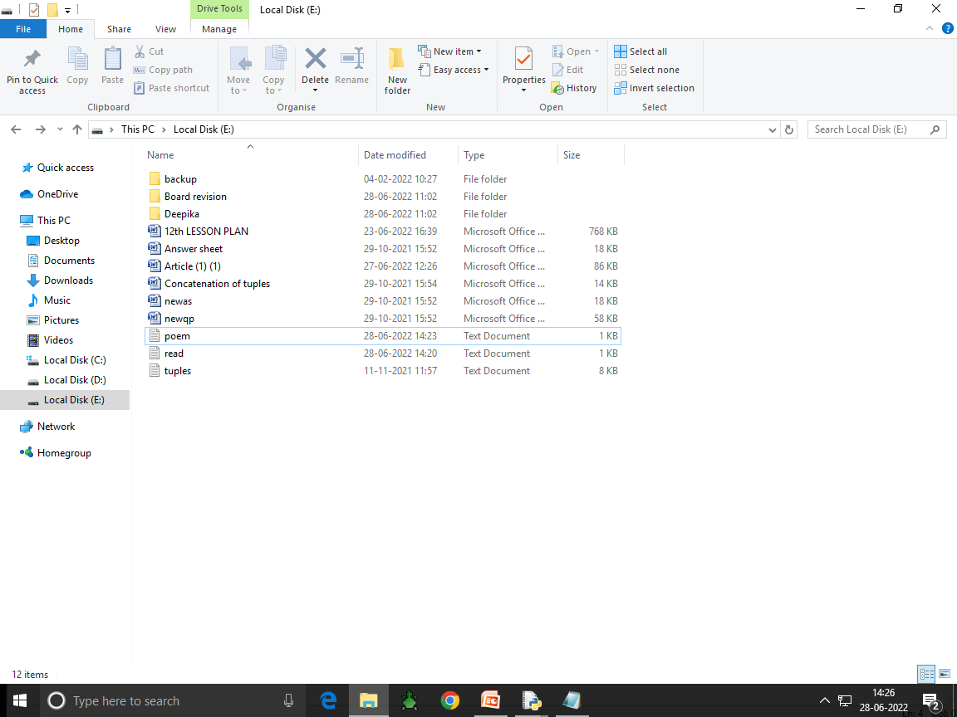

Slide 12
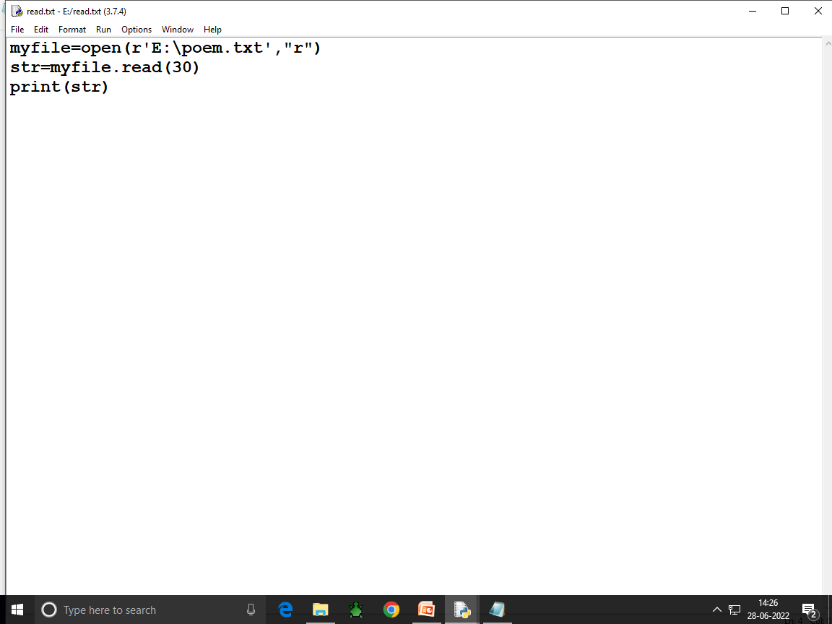

Slide 13
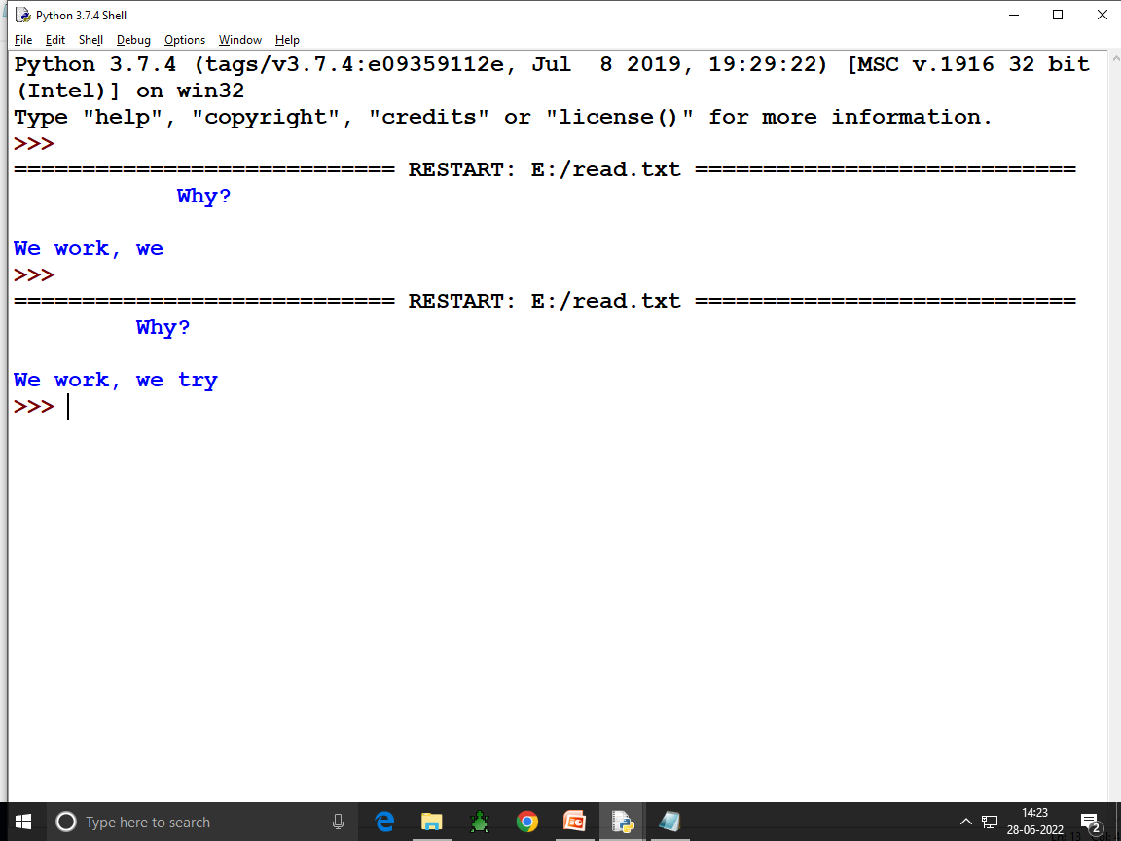

Slide 14
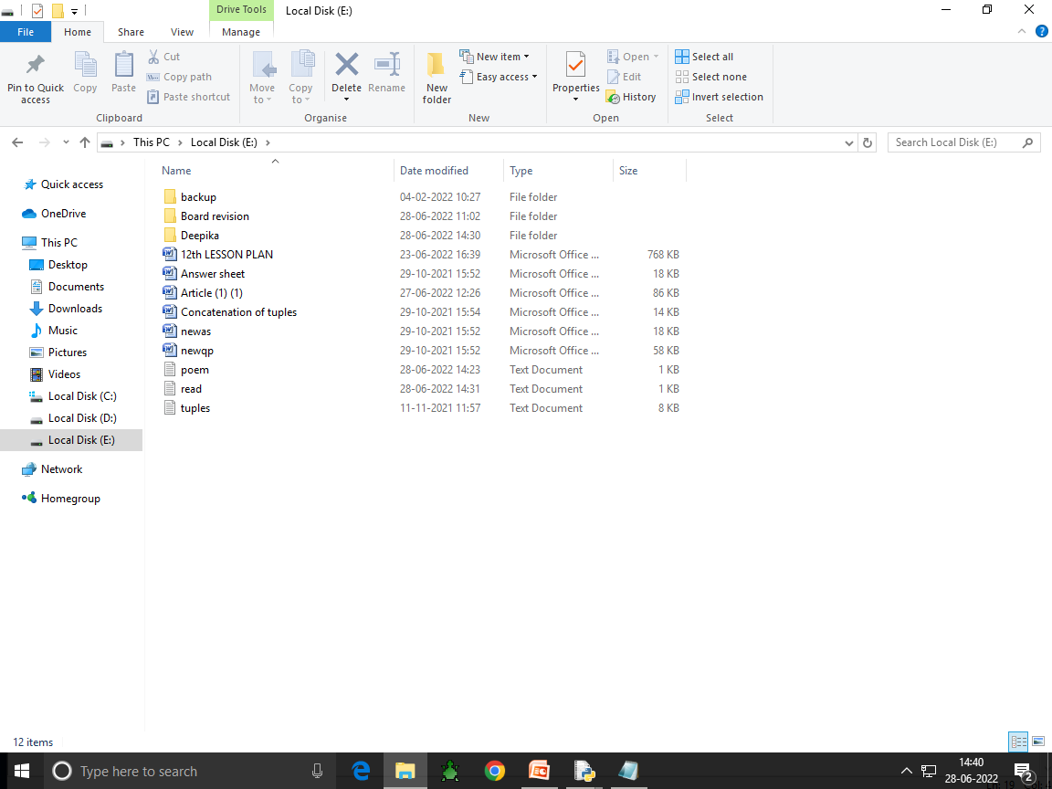

Slide 16
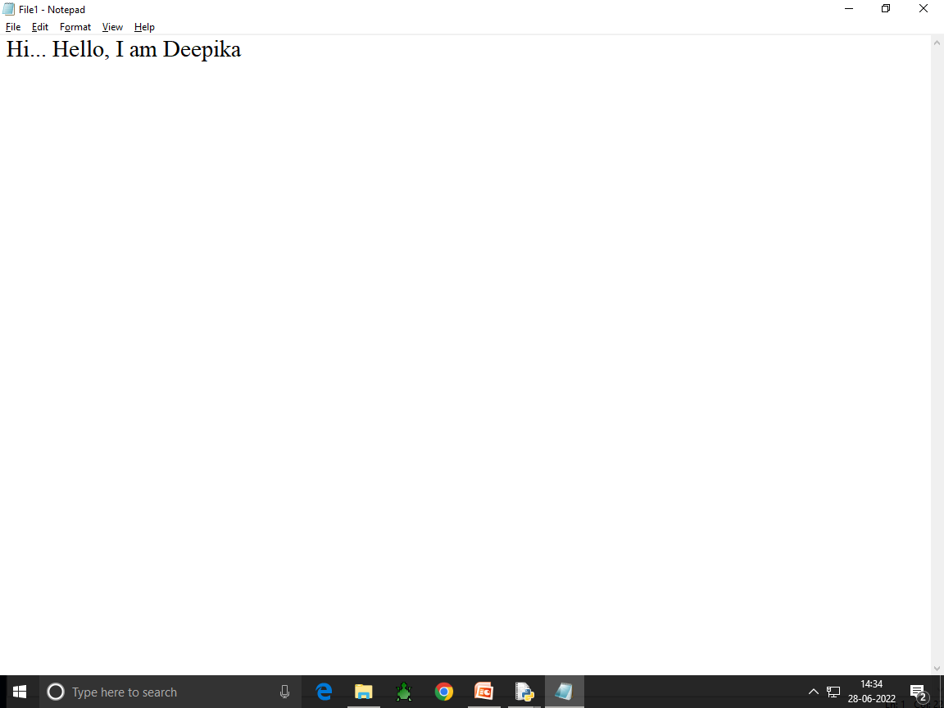

Slide 17
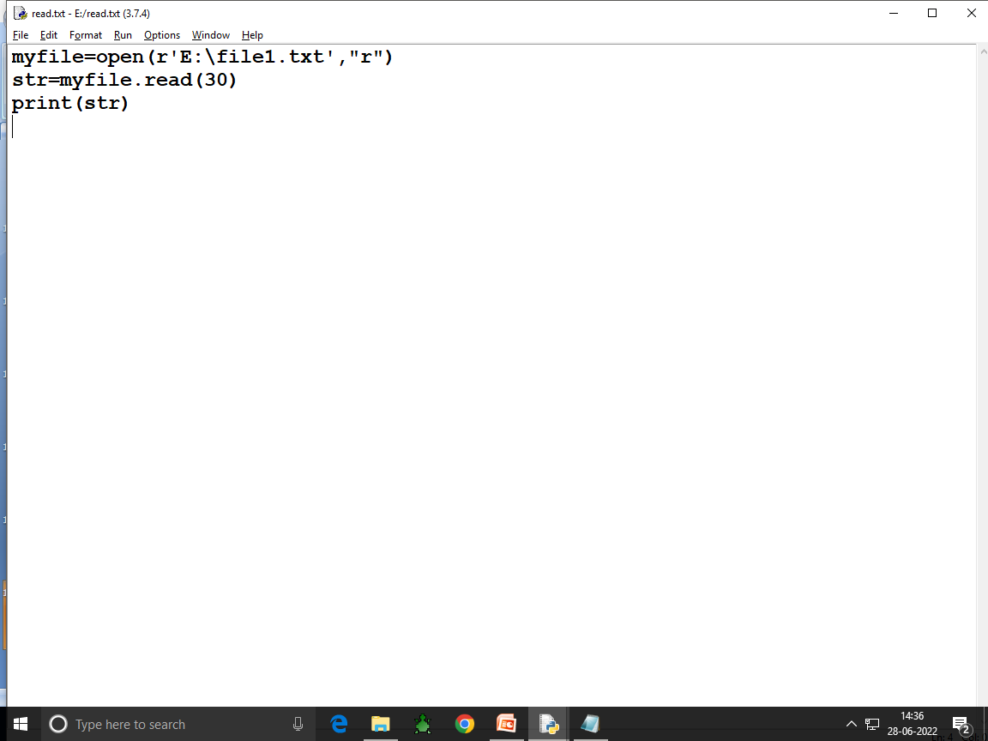

Slide 18
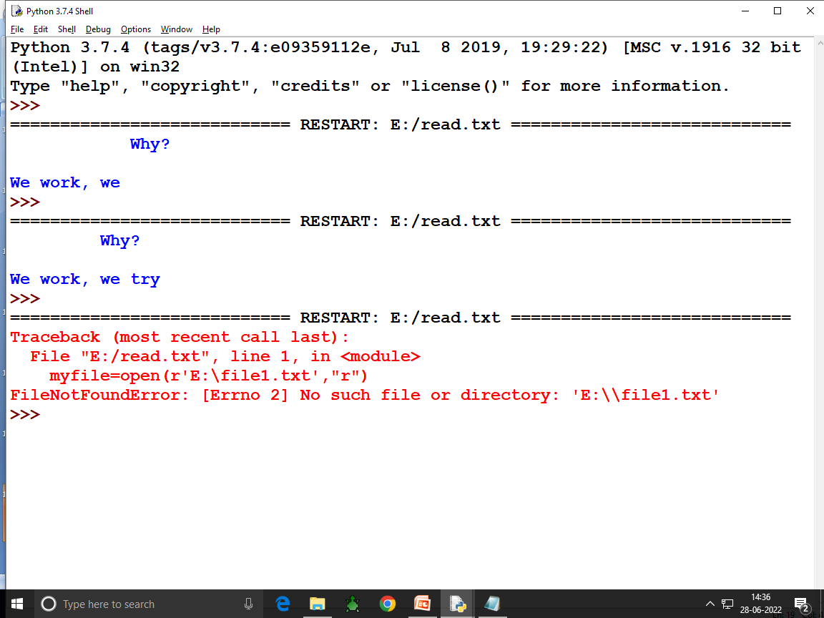

Slide 20
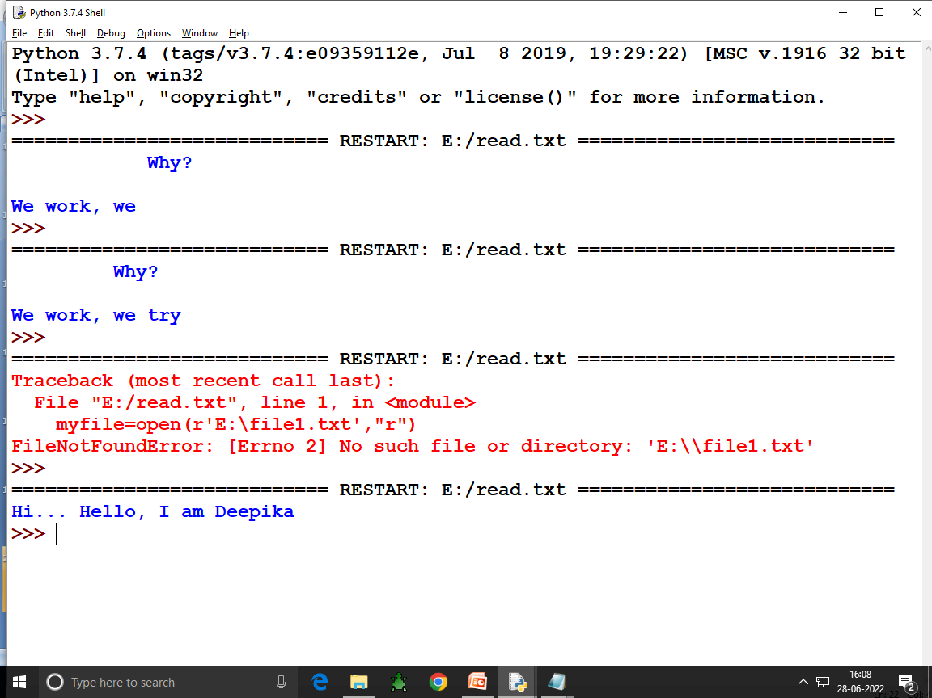

Slide 22
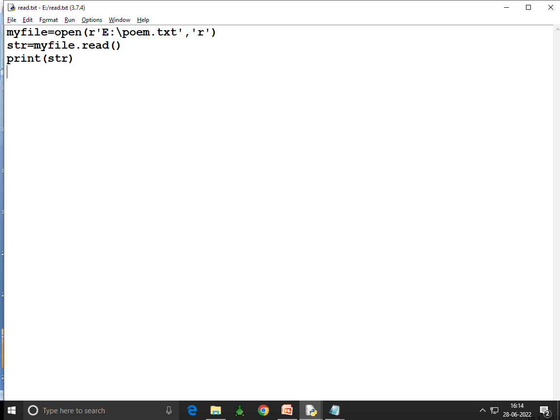

Slide 23
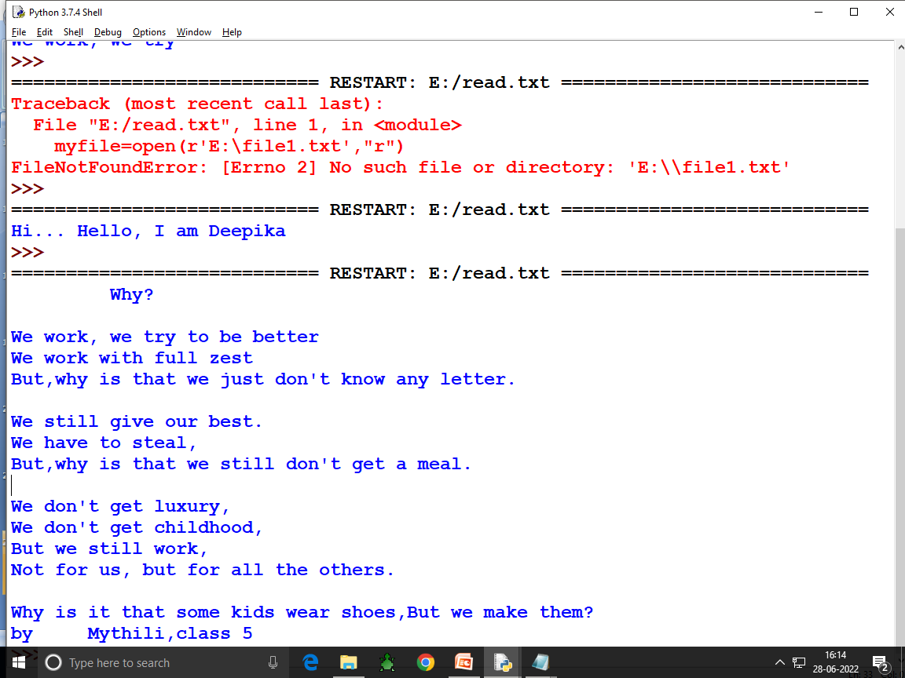

Slide 24
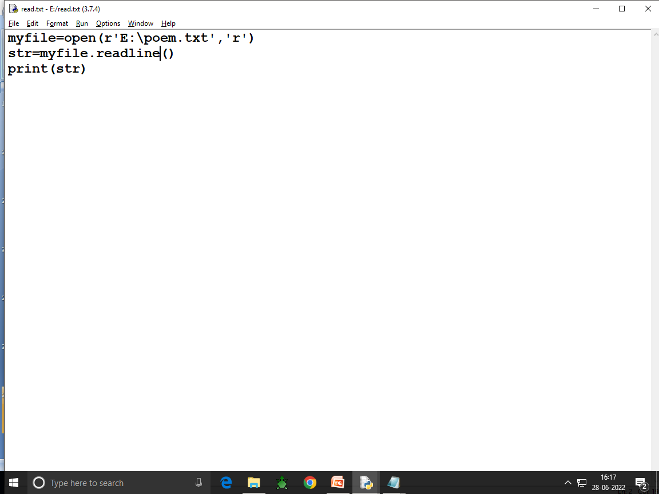

Slide 25
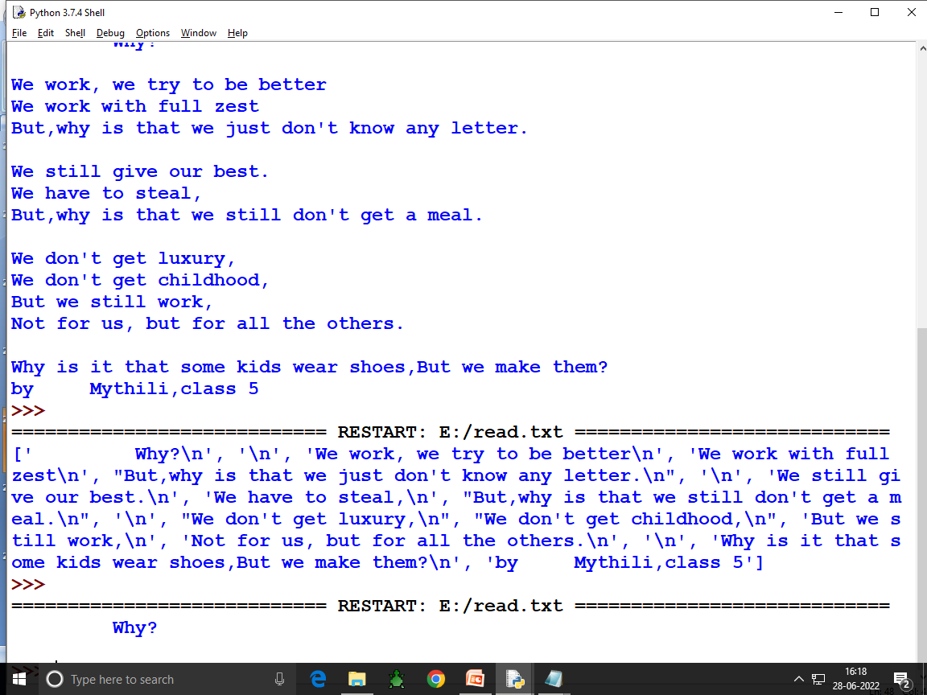

Slide 26
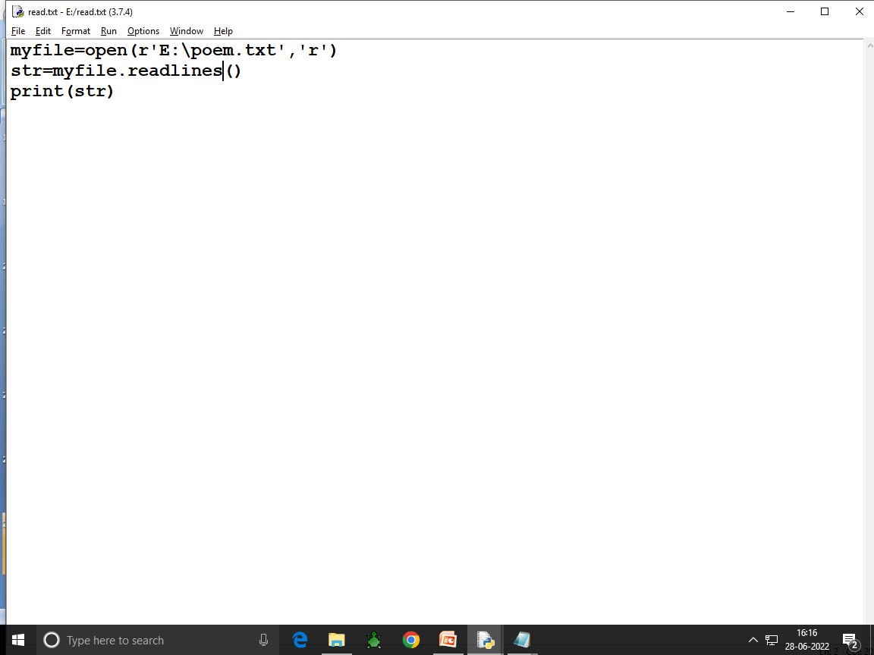

Slide 27
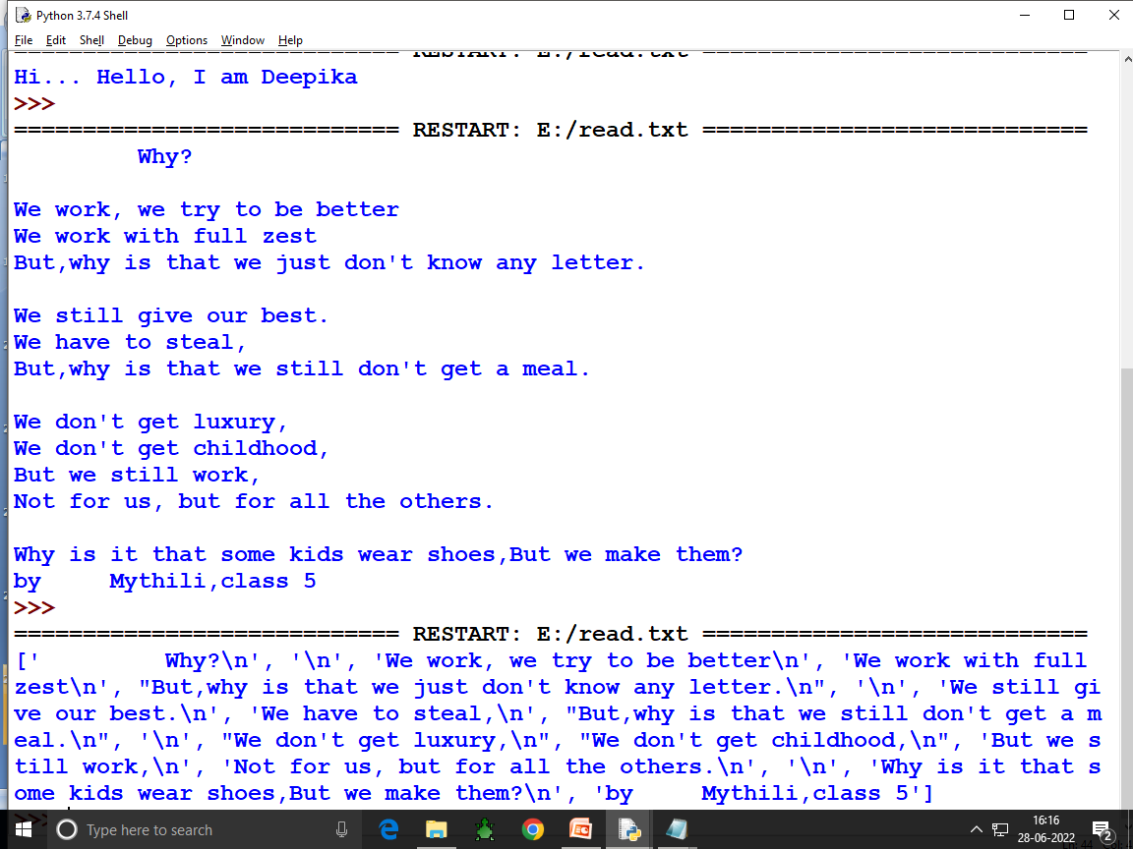

Slide 28
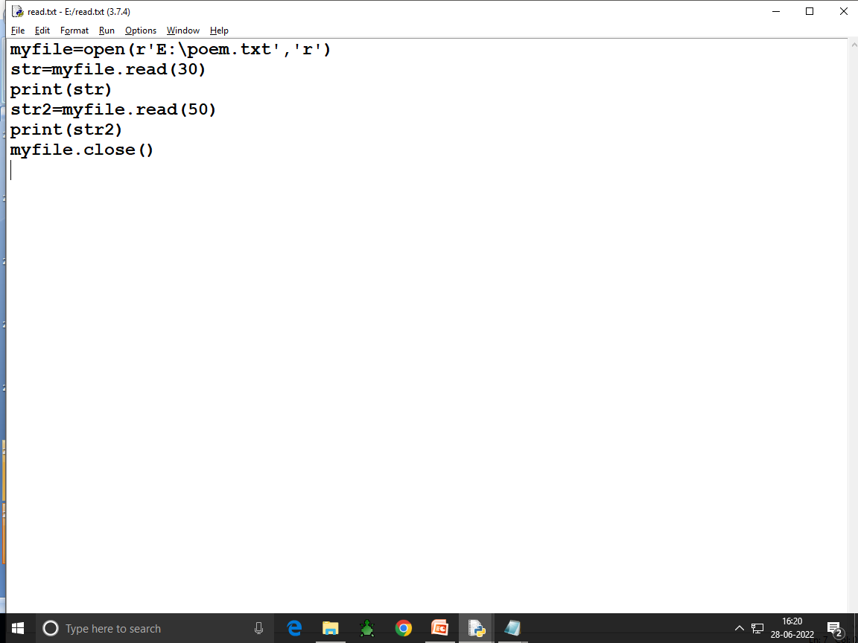

Slide 29
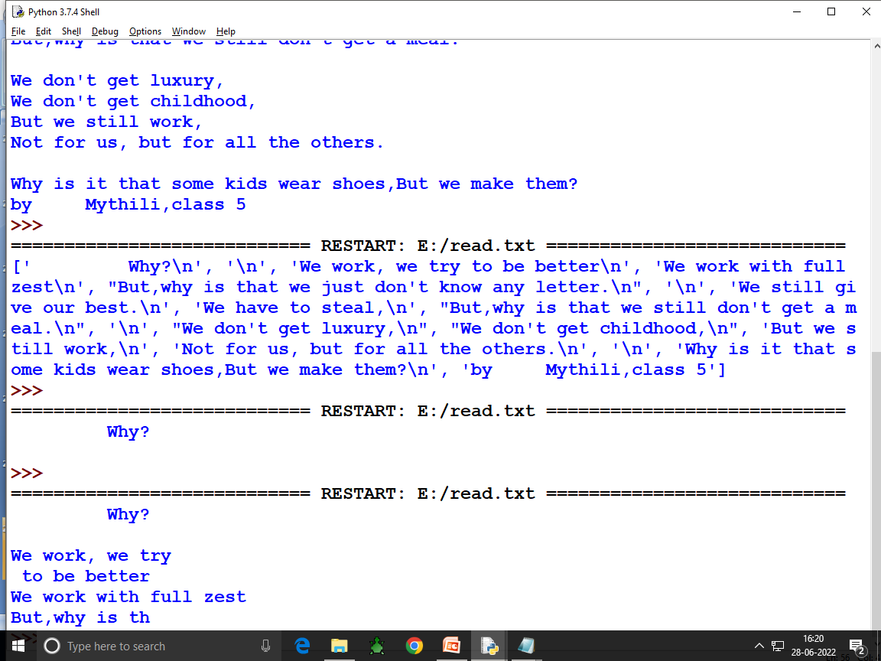

Slide 30
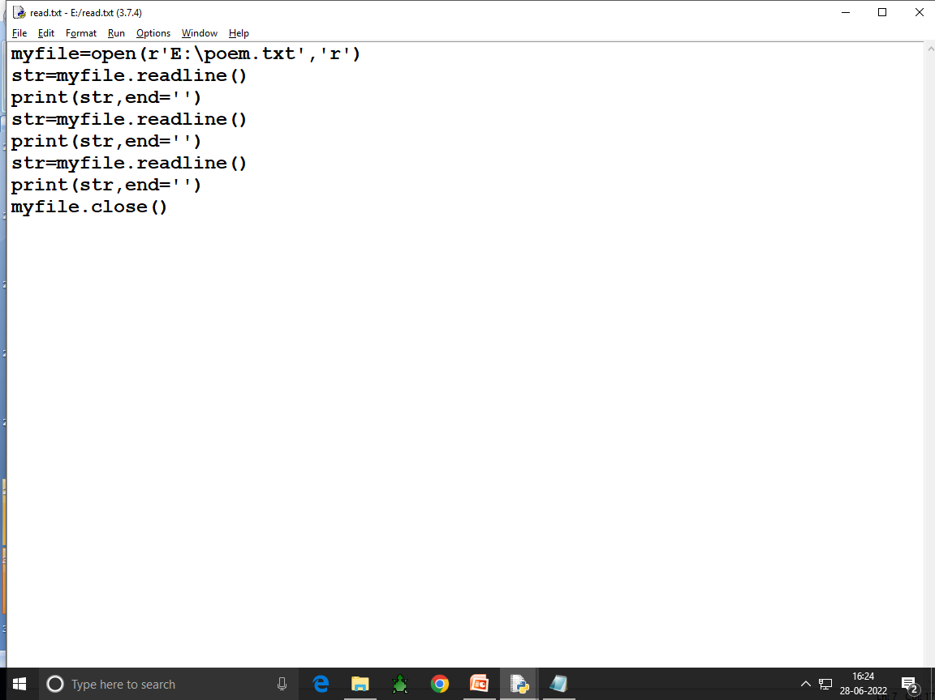

Slide 31
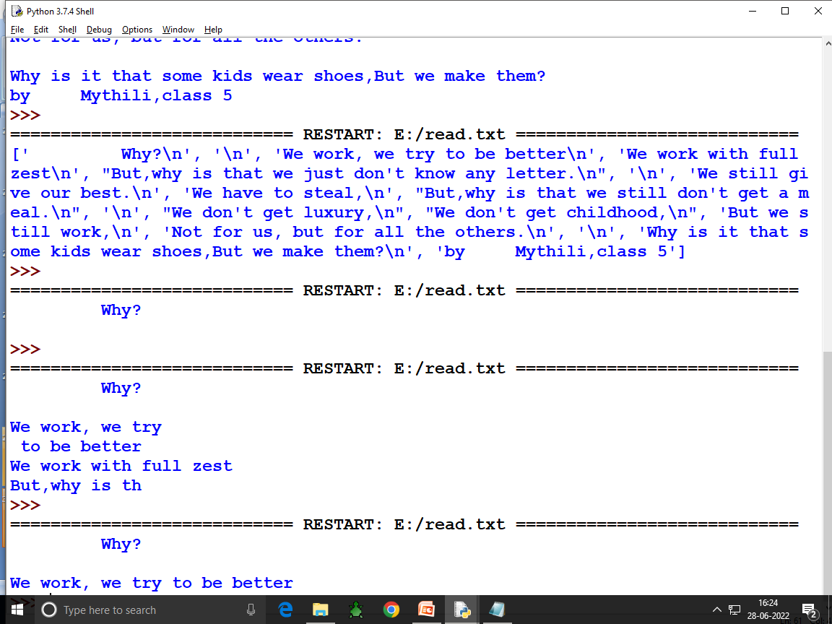

Slide 33
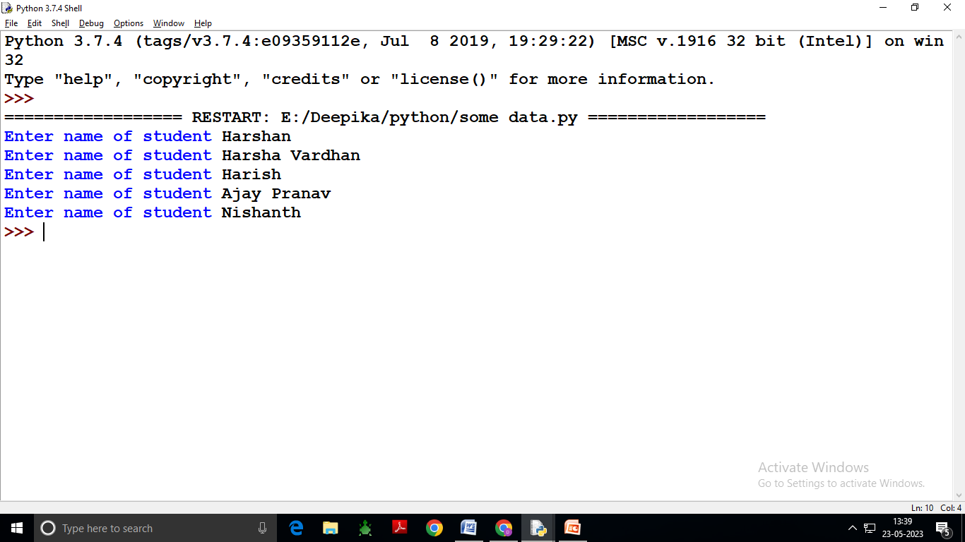

Slide 34
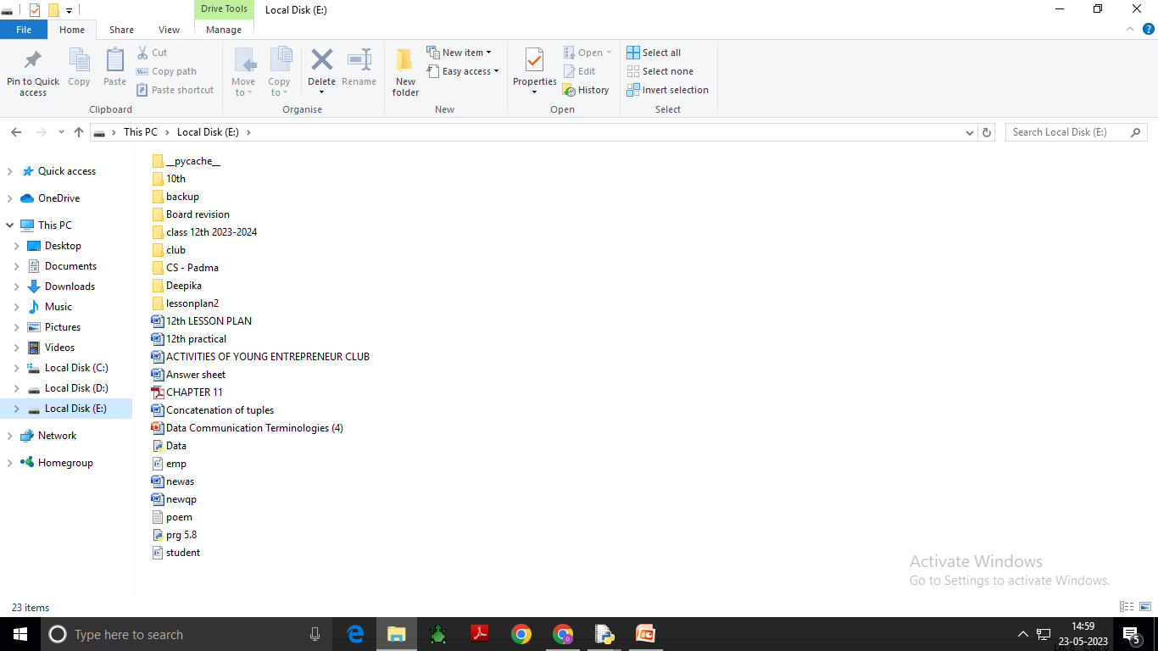

Slide 35
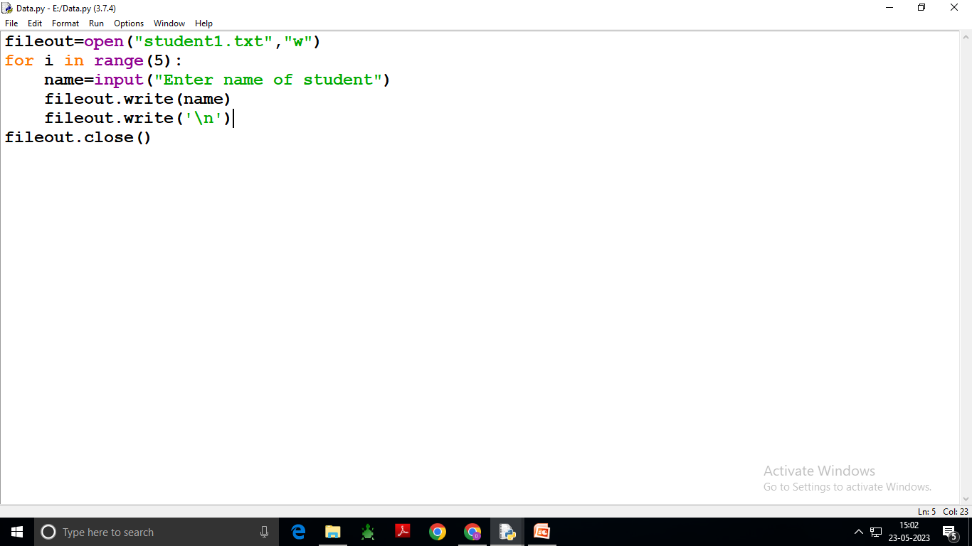

Slide 36
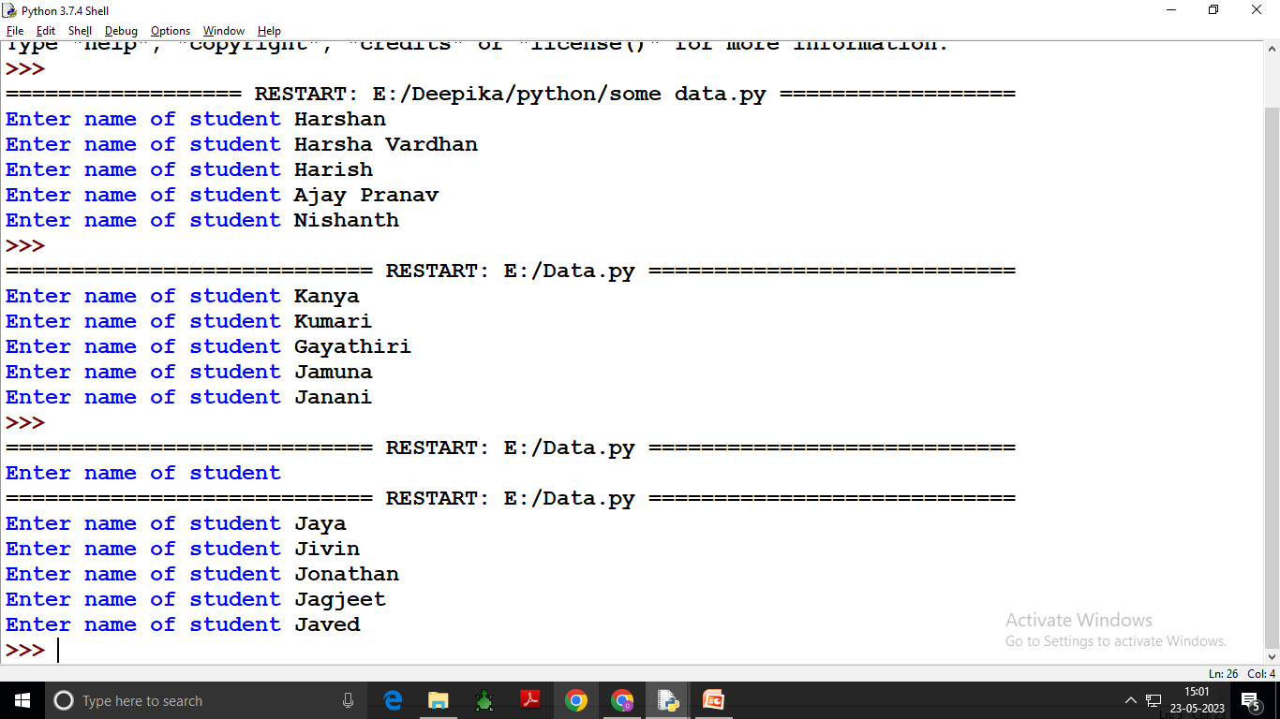

Slide 37
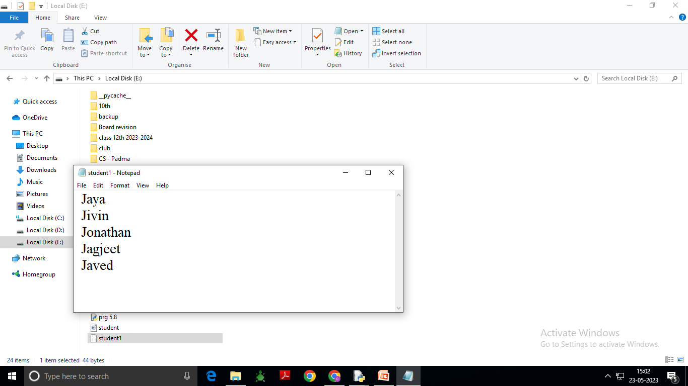

Slide 38
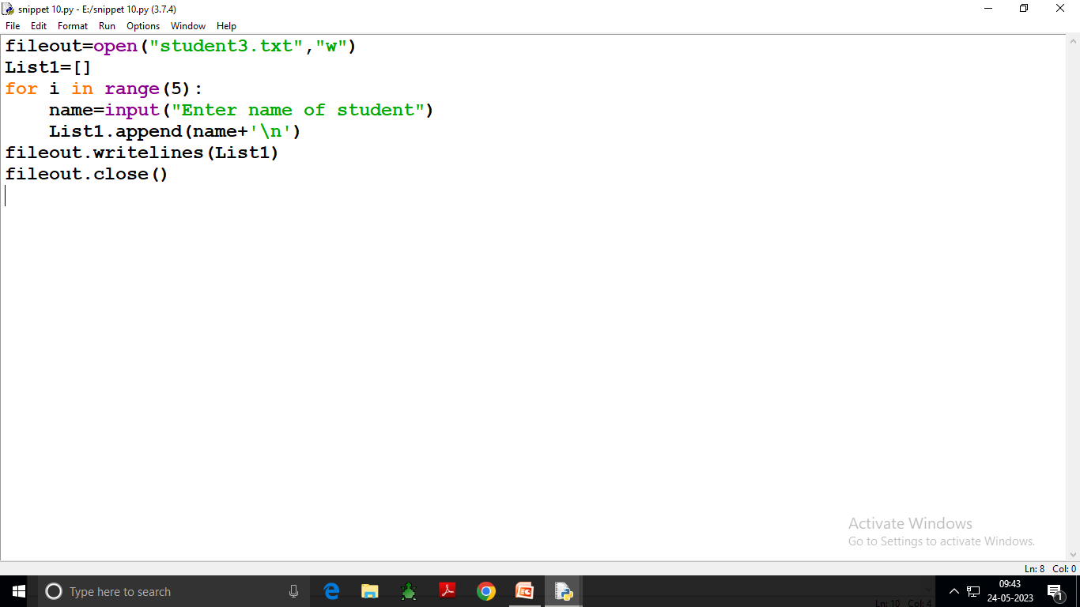

Slide 39
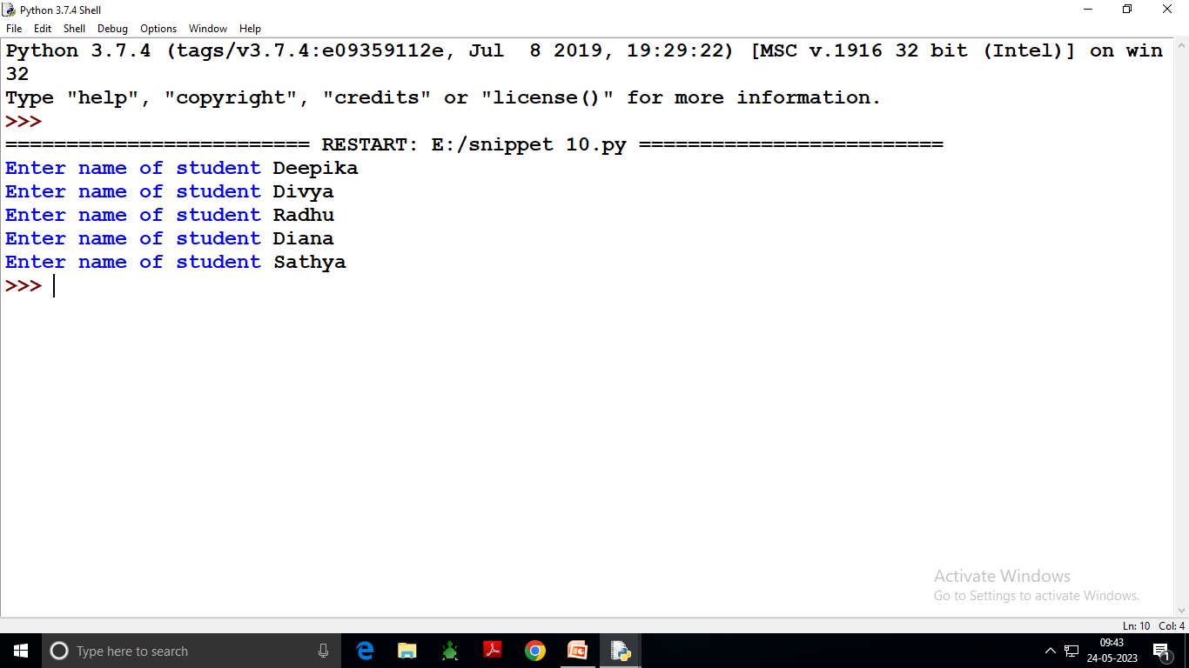

Slide 40
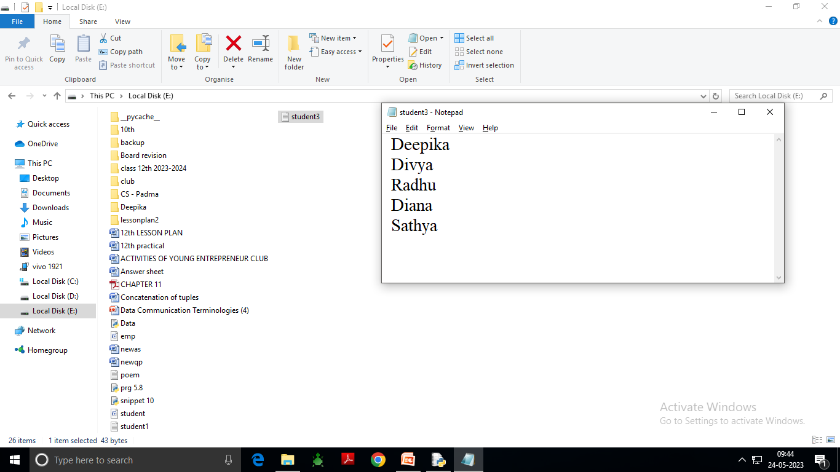

Slide 41
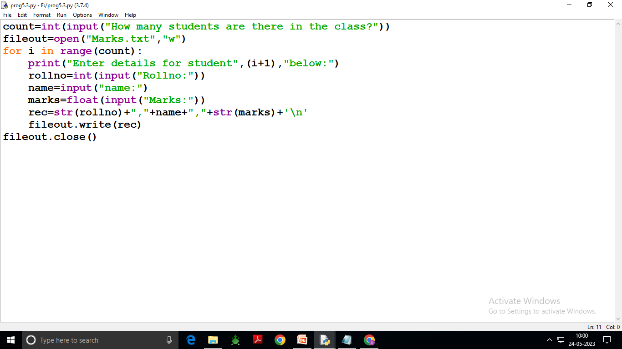

Slide 42
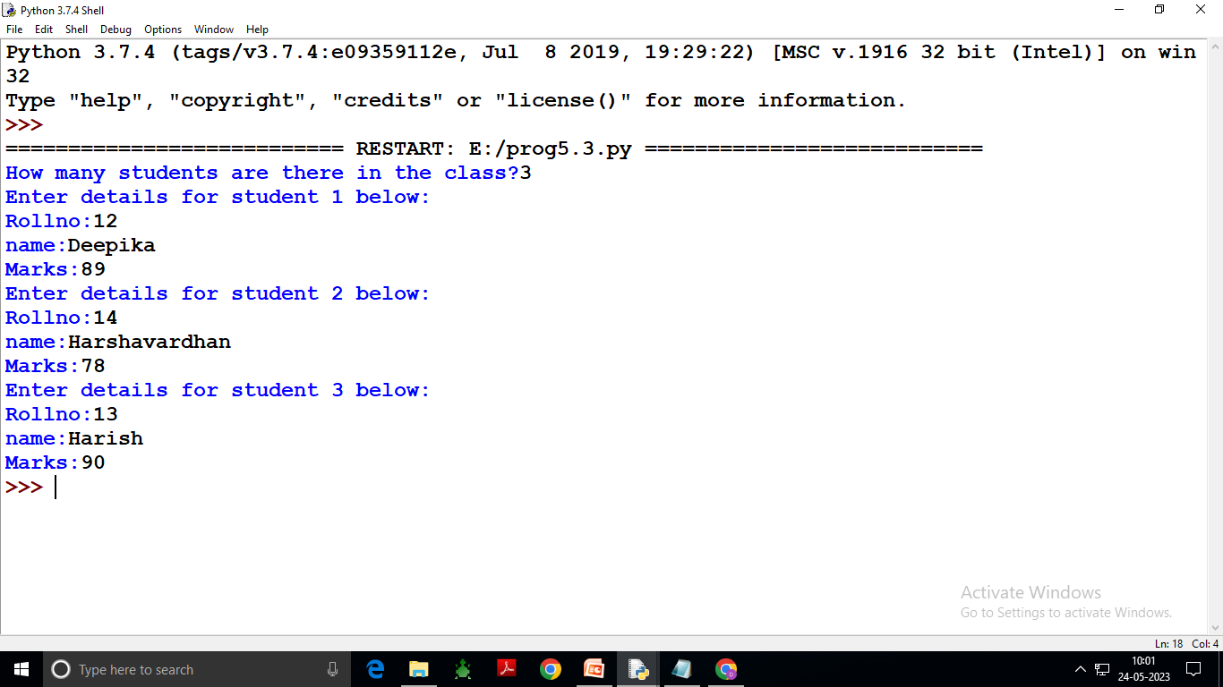

Slide 43
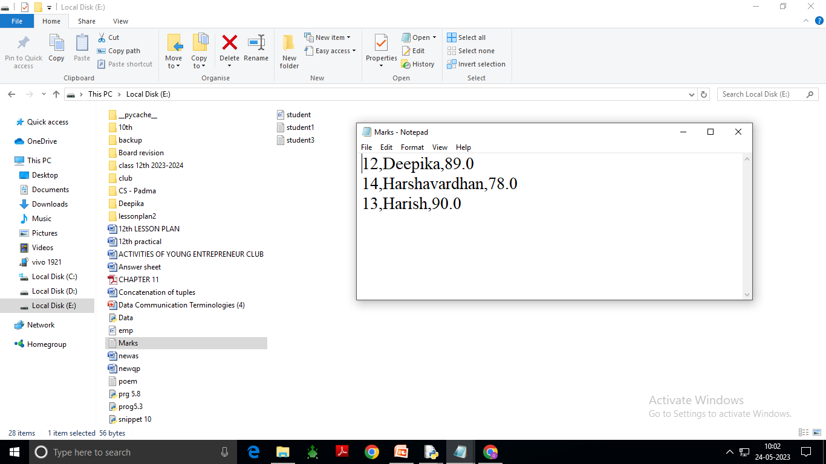

Slide 44
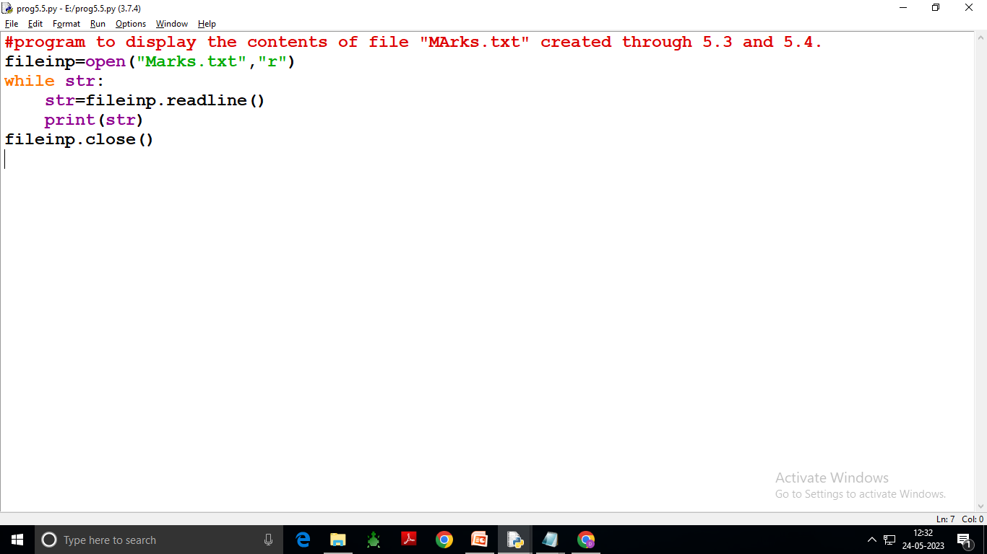

Slide 45
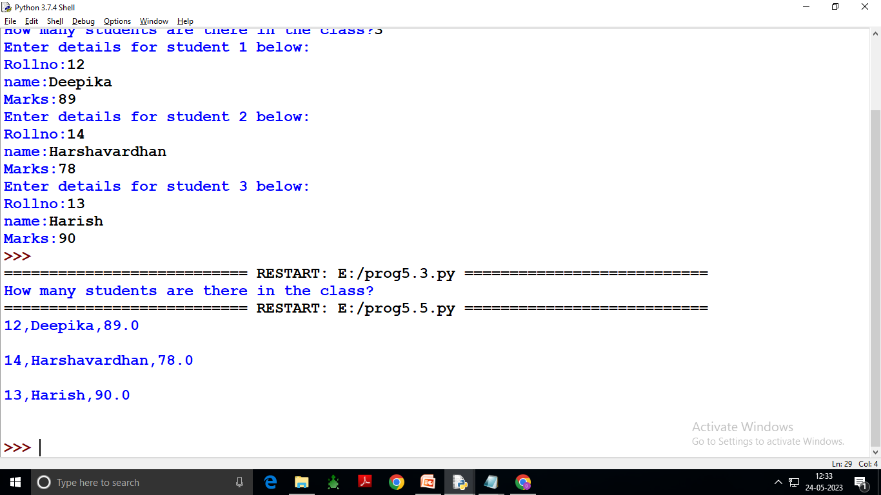

Slide 47
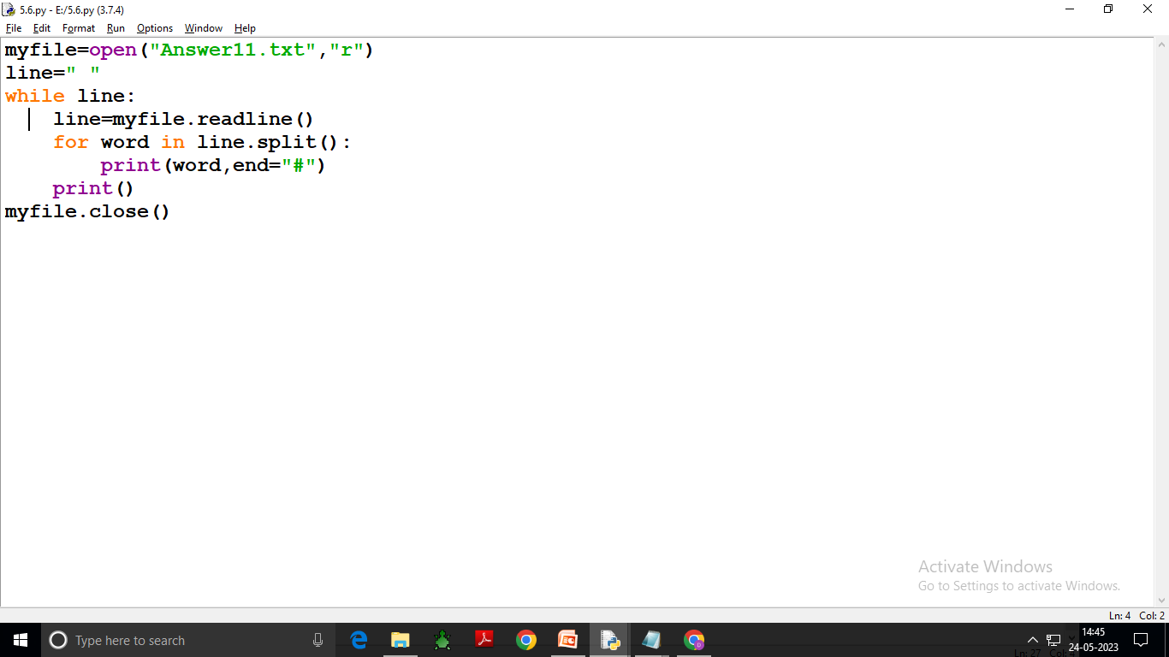

Slide 49
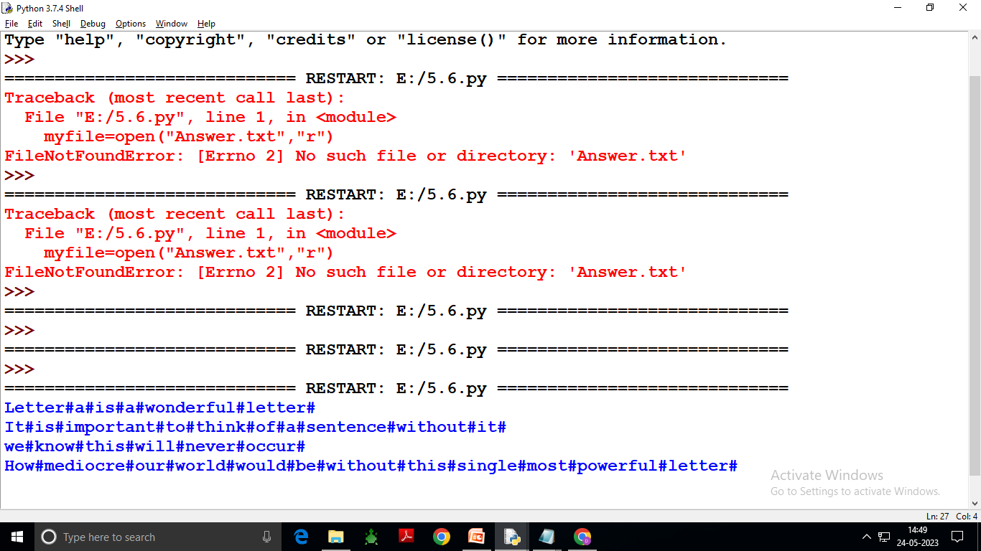

Slide 50
Flush() Function: What is the difference between flush and close in Python? Flush() writes the content of the buffer to the destination and makes the buffer empty for further data to store but it does not closes the stream permanently . That means you can still write some more data to the stream. But close() closes the stream permanently.

Slide 51
Strip function The Strip() method in Python removes or truncates the given characters from the beginning and the end of the original string. The default behavior of the strip() method is to remove the whitespace from the beginning and at the end of the string. rstrip(): Python rstrip() method removes all the trailing characters from the string. It means it removes all the specified characters from right side of the string. Lstrip(): The lstrip() method returns a copy of the string with leading characters removed (based on the string argument passed). The lstrip() removes characters from the left based on the argument (a string specifying the set of characters to be removed).

Slide 52
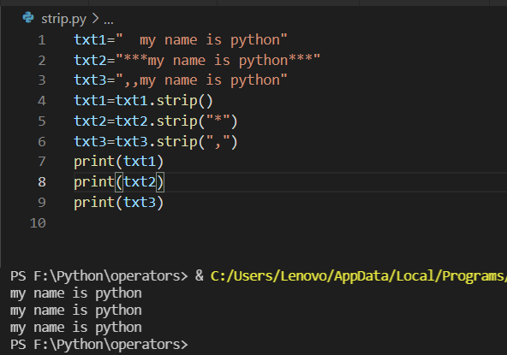

Slide 55
File Pointer Every file maintains a file pointer which tells the current position in the file where writing or reading will take place.(A file pointer in this context works like a book-mark in a book). Whenever you read something from the file or write onto a file,then these two things happen involving file-pointer: (i) This operation takes place at the position of file-pointer and (ii) File-pointer advances by the specified number of bytes.

Slide 58
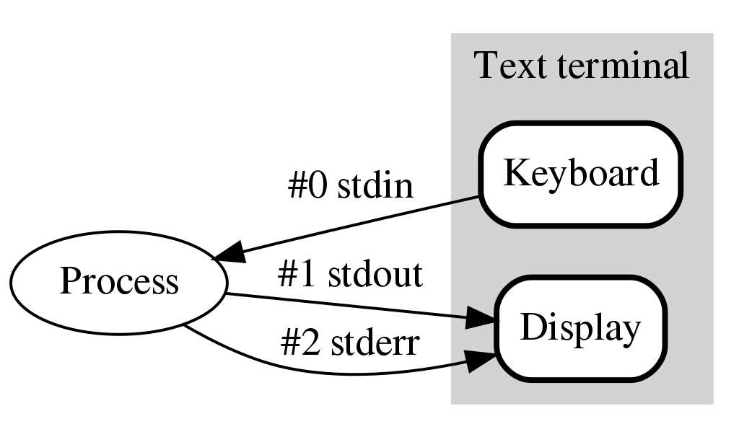

Slide 59
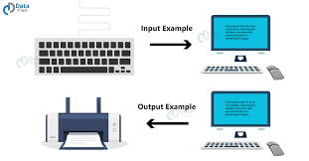

Slide 60
A relative path describes the location of a file relative to the current (working) directory*. An absolute path describes the location from the root directory.

Slide 61
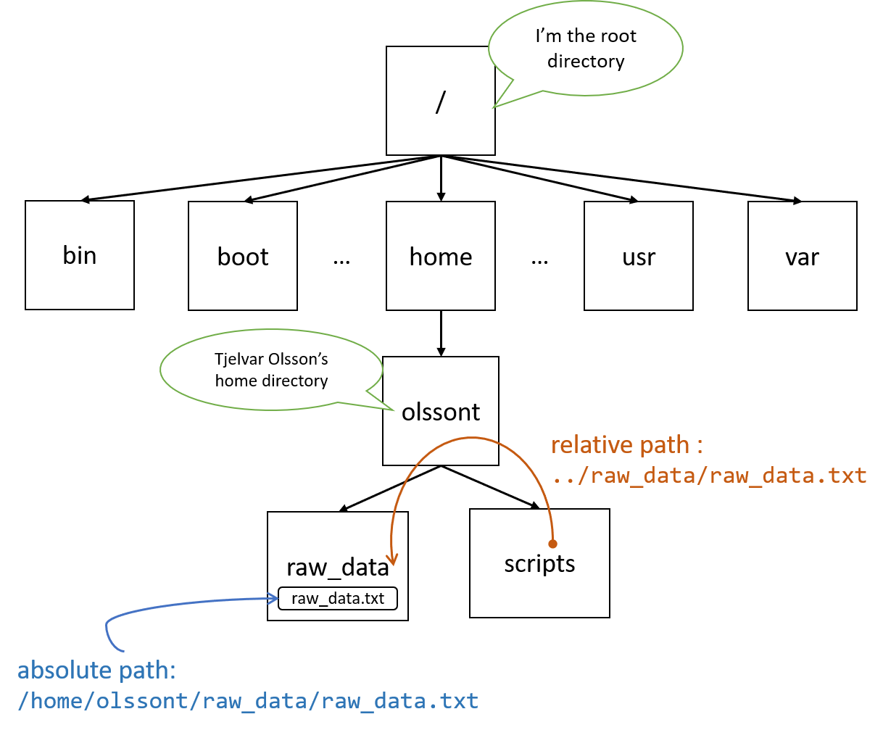

Slide 62
The absolute paths are from the topmost level of the directory structure .The relative paths are relative to current working directory denoted as a dot(.)while its parent directory is denoted with two dots(..)

Slide 63
Working with Binary Files: “Pickling” is the process whereby a Python object hierarchy is converted into a byte stream, and “unpickling” is the inverse operation, whereby a byte stream (from a binary file or bytes-like object) is converted back into an object hierarchy.

Slide 64
Working with Binary Files: Steps to work with a binary file in Python: 1.Import pickle module. We need to write import statement at the start of program to import pickle module as: import pickle. 2.Open binary file in the required file mode (read mode or write mode). ... 3.Process binary file by writing\reading objects. ... Close the file.

Slide 65
1. Python program to write a list namely list1 in the file named file1.txt import pickle f1=open("file1.txt","wb") list1=[1,'Lovejot','Teacher'] pickle.dump(list1,f1) f1.close()

Slide 66
2. Python program to write a tuple namely t1 in the file named file2.txt import pickle f2=open("file2.txt","wb") t1=(2,'Sumit','XII'] pickle.dump(t1,f2) f2.close()

Slide 67
. Python program to write a dictionary namely d1 in the file named file3.txt import pickle f3=open("file3.txt","wb") d1={'Rollno':1, name:'Anil'} pickle.dump(d1,f3) f3.close()

Slide 68
Writing onto a binary file=Pickling pickle.dump(<object-to-be-written>,<file handle-of-open-file>) pickle.dump(list1,file1) pickle.dump(student1,file2)

Slide 69
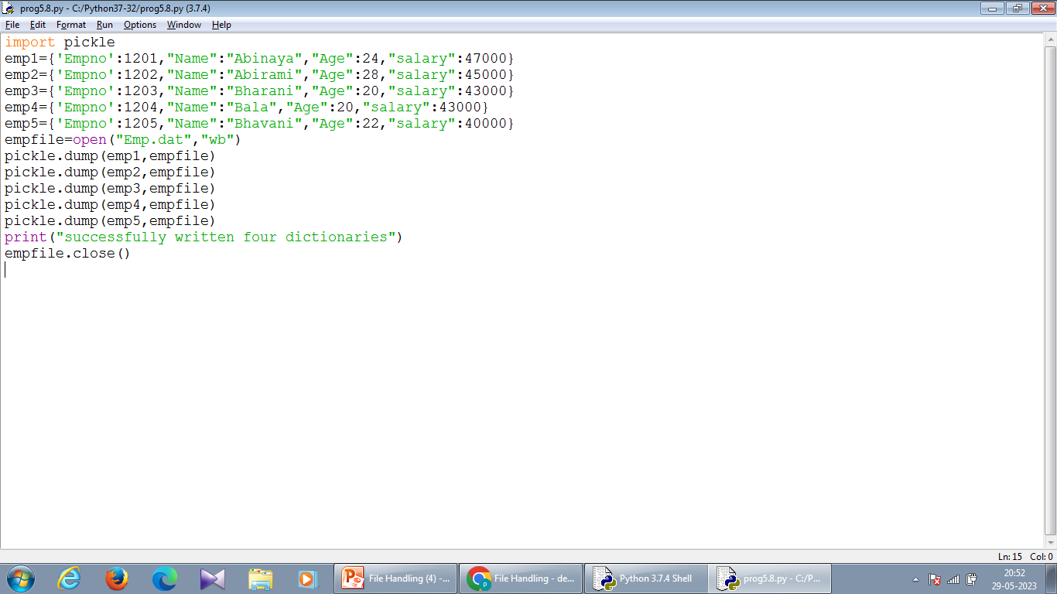

Slide 71
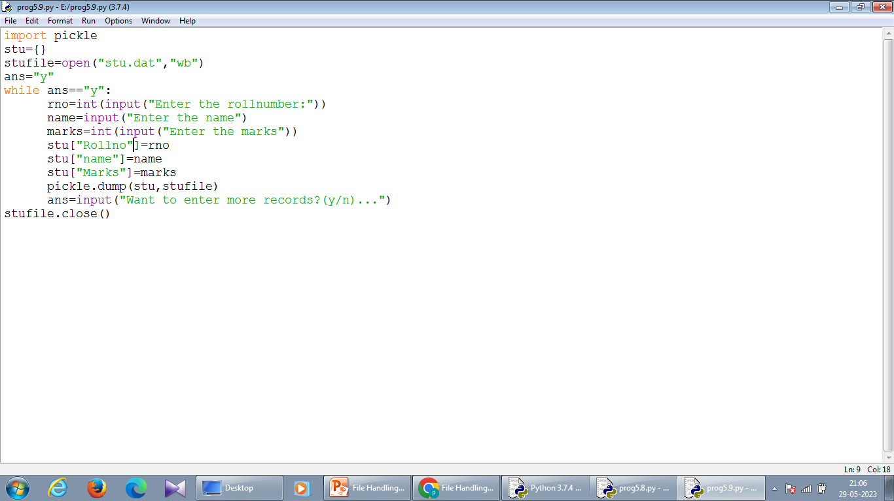

Slide 72
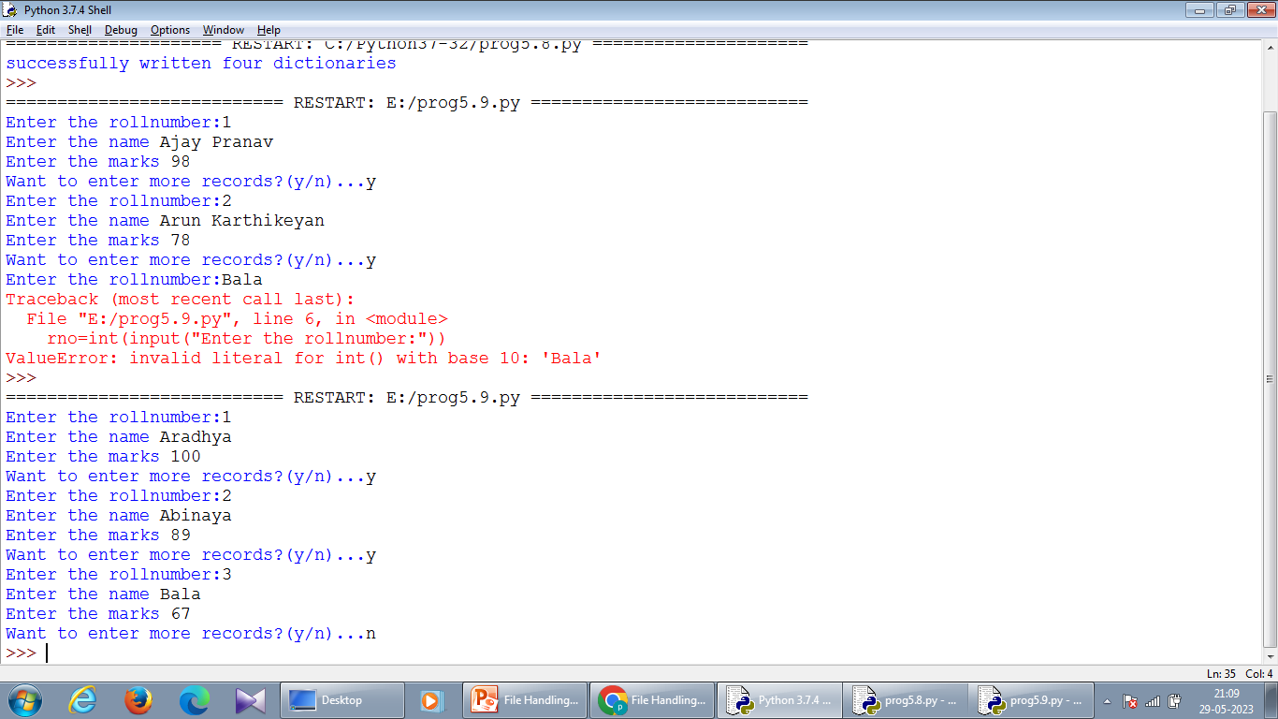

Slide 73
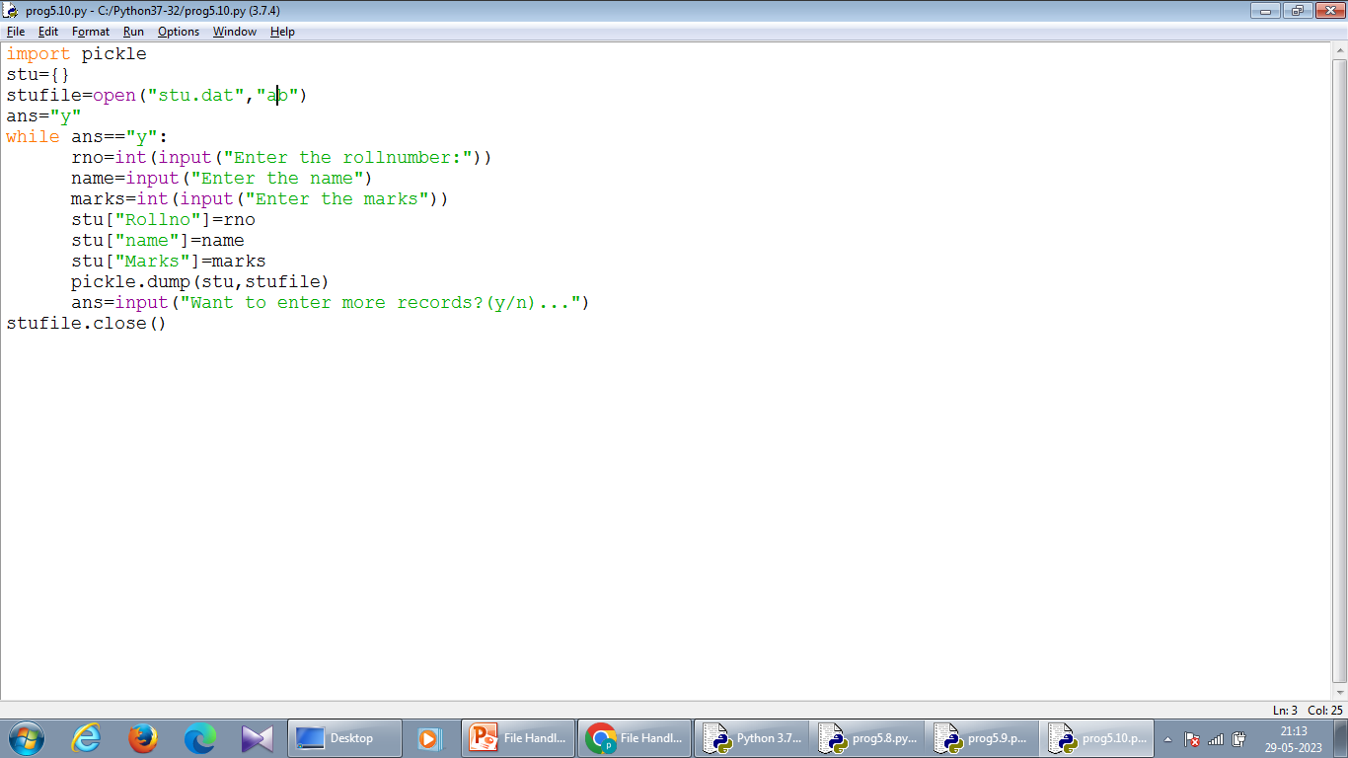

Slide 74
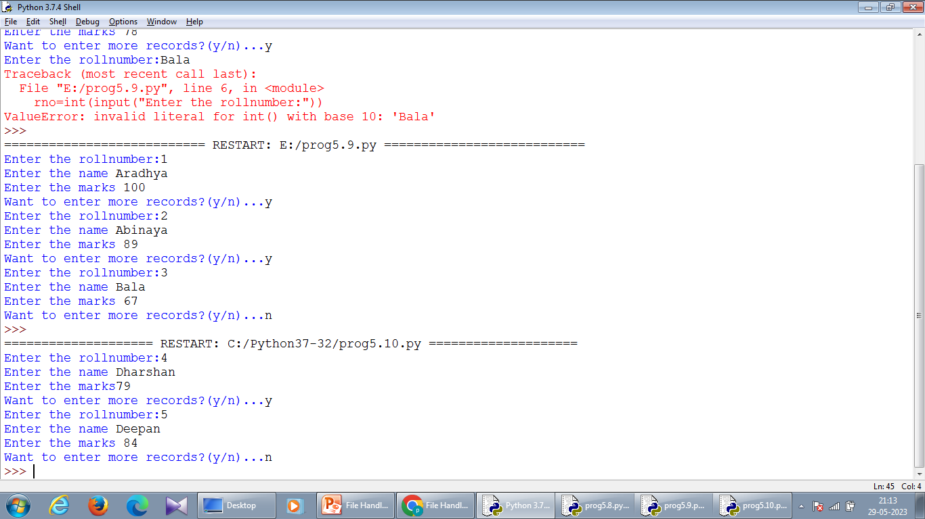

Slide 75
Reading from a Binary file-Unpickling <object>=pickle.load(<filehandle>) nemp=pickle.load(fout)

Slide 76
The try block lets you test a block of code for errors.
The except block lets you handle the error. Example The try block will generate an exception, because x is not defined: try: print(x) except: print("An exception occurred")

Slide 77
#The try block will generate a NameError, because x is not defined: try: print(x) except NameError: print("Variable x is not defined") except: print("Something else went wrong")

Slide 78
Else You can use the else keyword to define a block of code to be executed if no errors were raised: In this example, the try block does not generate any error: try: print("Hello") except: print("Something went wrong") else: print("Nothing went wrong")

Slide 80
In Python, with statement is used in exception handling to make the code cleaner and much more readable. It simplifies the management of common resources like file streams. Observe the following code example on how the use of with statement makes code cleaner. Within the block of code opened by “with”, our file is open, and can be read from freely. However, once Python exits from the “with” block, the file is automatically closed.

Slide 81
With statement as: with open(<filename>,<mode>) as <file handle>: #use pickle.load here in this with block #perform other file manipulation task in this with block

Slide 86
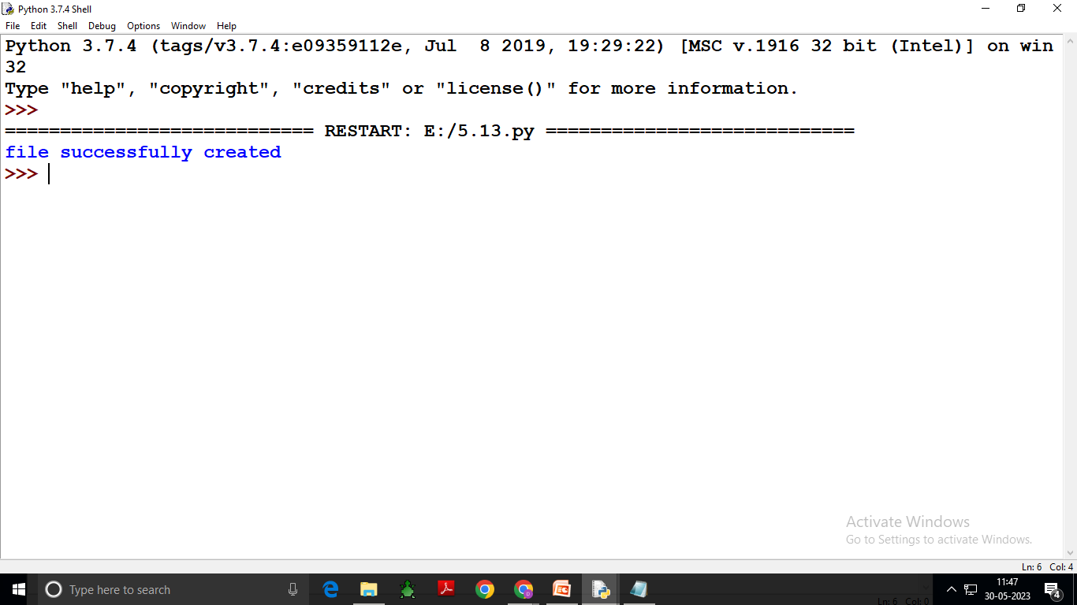

Slide 87
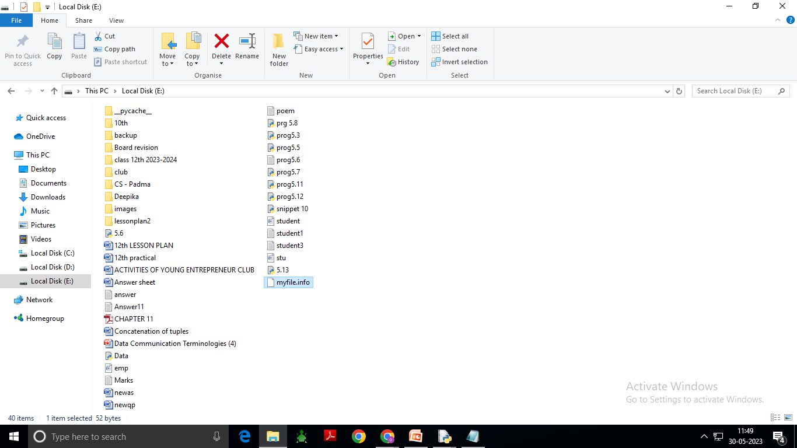

Slide 88
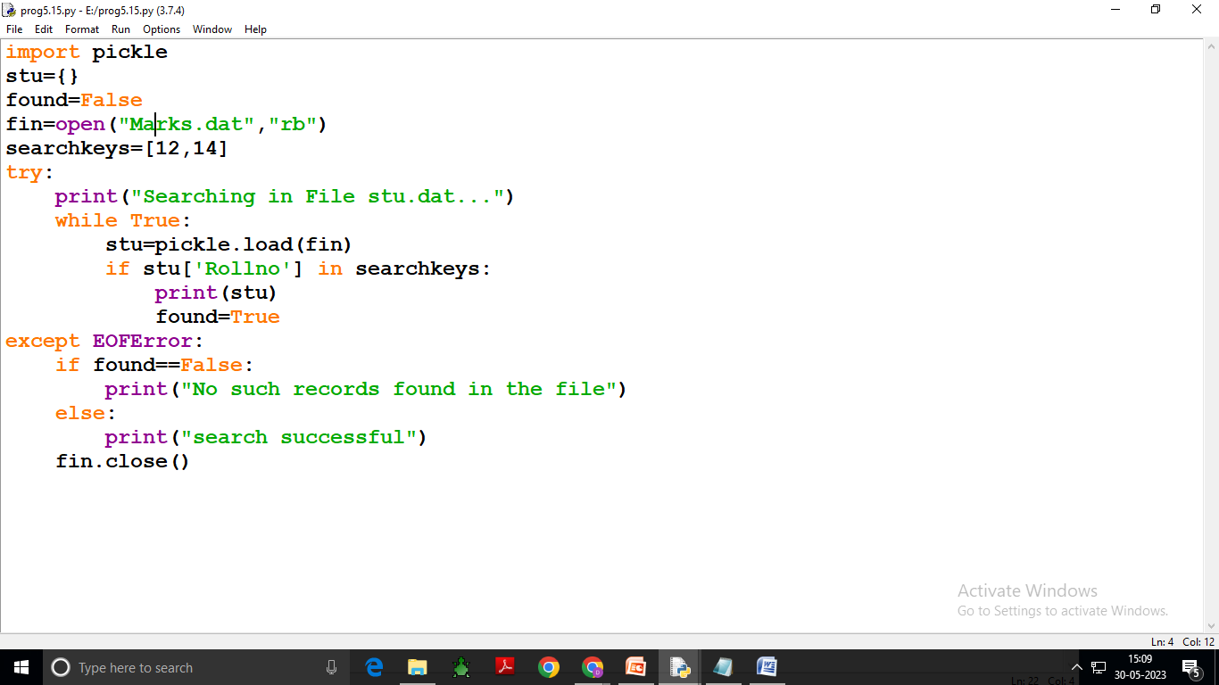

Slide 89
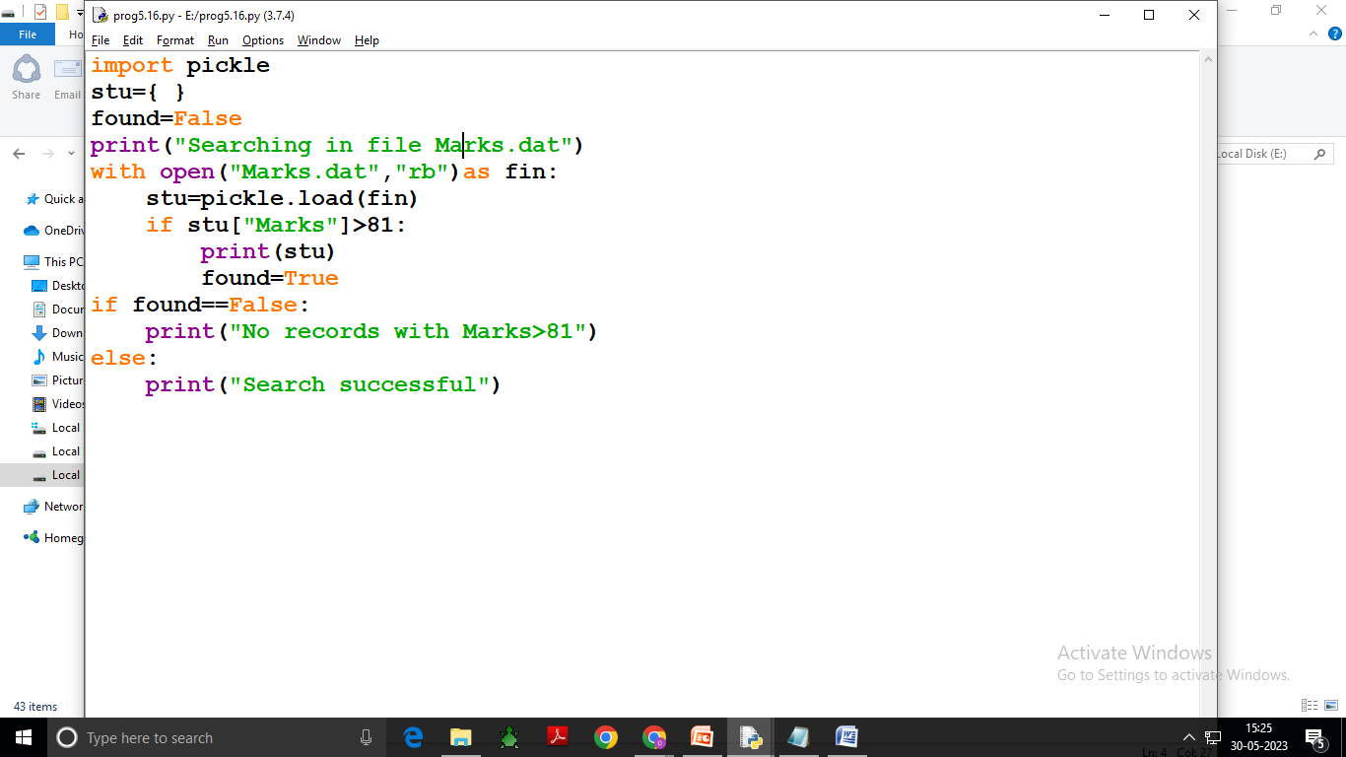

Slide 90
The tell function is used to determine the current position of the file pointer, and the seek function is used to move the file pointer to the specified position of the file.

Slide 91
Tell() function in Python is used to find the current position of the file pointer from the beginning in the given file. f.tell() fh=open(“Marks.txt”,”r”) print(“Initially file-pointer’s position at :”,fh.tell()) print(“3 bytes read are:”,fh.read(3)) print(“After previous read,current position of file-pointer:”,fh.tell())

Slide 92
Output: Initially file-pointer’s position is at :0 3bytes read are:12, After previous read,current position of file-pointer:3

Slide 93
seek() function in Python is used to bring the file pointer to the given specified position. f.seek(offset, position) offset- is a number specifying number of bytes. Mode ->is a number 0 or 1 or 2 signifying 0 for beginning of file(to move file-pointer beginning of file)It is default position(when no mode is specified) 1 for current position of file pointer(to move file pointer to write current position of it) 2 for end of file(to move file pointer to end of file) file object-is the handle of open file.

Slide 94
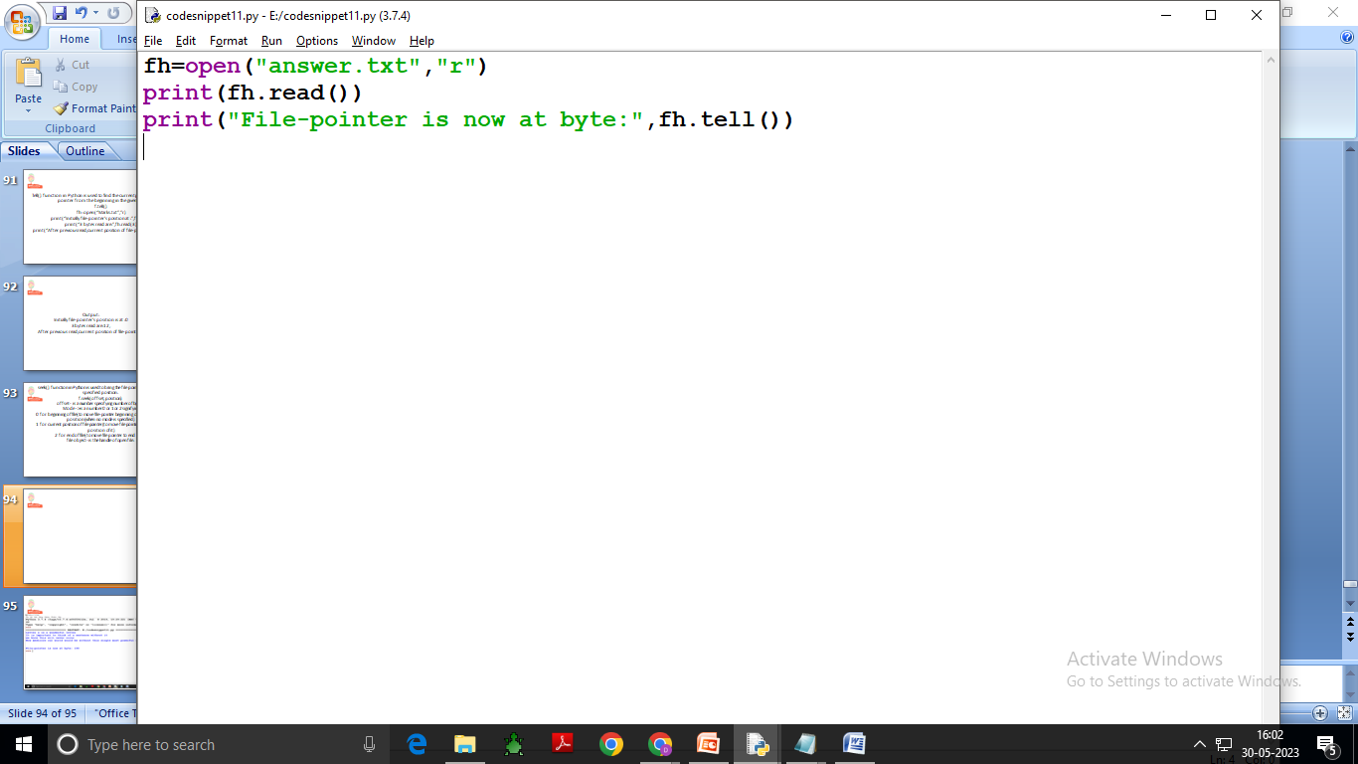

Slide 95
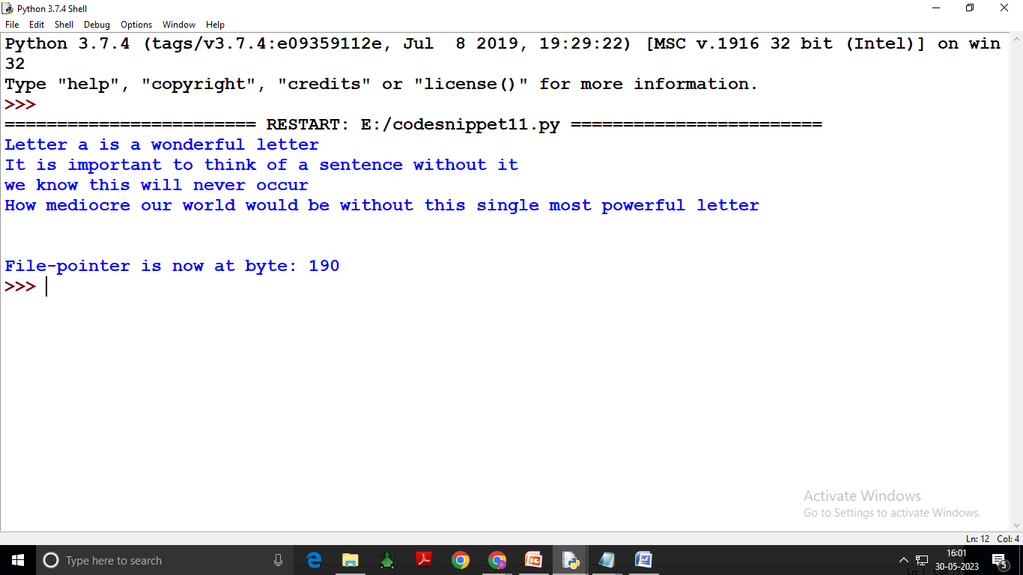

Slide 96
Working with CSV Files What is a CSV? CSV (Comma Separated Values) is a simple file format used to store tabular data, such as a spreadsheet or database. A CSV file stores tabular data (numbers and text) in plain text. Each line of the file is a data record. Each record consists of one or more fields, separated by commas. The use of the comma as a field separator is the source of the name for this file format. For working CSV files in Python, there is an inbuilt module called csv.

Slide 97
The separator character of CSV files is called a delimiter.Default and most popular delimiter is comma other popular delimiters include the tab(\t),colon(:)pipe(|) and semi-colon(;) characters.

Slide 98
Python CSV Module The csv module of python provides functionality to read and write tabular data in CSV format.It provides to specific types of objects-the reader and writer objects-to read and write into CSV files.The csv module’s reader and writer objects read and write delimited sequences as records in a CSV file. Import csv

Slide 99
Opening and closing CSV files A CSV file is opened in the same way as you open any other text file,but make sure to do the following two things: i.specify the file extension as .csv ii.open the file like other files Eg: Dfile=open(“stu.csv”,”w”) or file1=open(“stu.csv”,”r”) An open CSV file is closed in the same manner as you close any other file as Dfile.close()

Slide 100
Like Text files,a CSV file will get created when opened in an output file mode and if it does not exist already.That is for the file modes,”w”,”w+”,”a”,”a+”,the file will get created if it does not exist already and if it exists already.then the file modes “w” and “w+”will overwrite the existing file and the file mode “a” or “a+” will retain the contents of the file.

Slide 101
Advantages: The csv files are popular because of these reason: i.Easier to create, ii.preferred export and import format for databases and spreadsheets ,iii.capable of storing large amounts of data.

Slide 102
Role of Argument newline in opening of CSV file

Slide 103
Writing in CSV Files Steps for writing a CSV file To write data into a CSV file, you follow these steps: First, open the CSV file for writing (w mode) by using the open() function. Second, create a CSV writer object by calling the writer() function of the csv module. Third, write data to CSV file by calling the writerow() or writerows() method of the CSV writer object. Finally, close the file once you complete writing data to it.

Slide 104
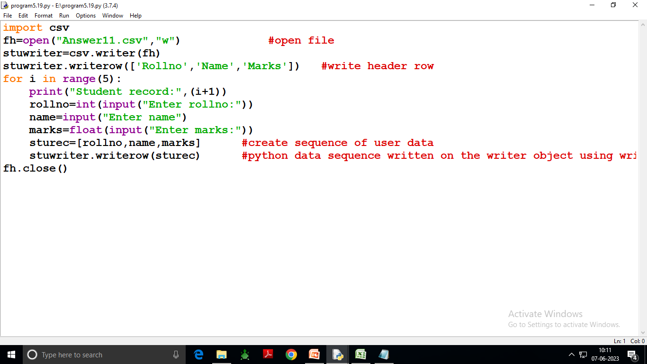

Slide 106
The writerows() method is used to write multiple rows at a time i.e., it can be used to write the contents of a 2-dimensional list into a csv file. Row lists can be written using this method.

Slide 109
Then, the csv. reader() is used to read the file, which returns an iterable reader object. The reader object is then iterated using a for loop to print the contents of each row.

Slide 110
Steps to read a CSV file using csv reader: Import the CSV library. import csv. Open the CSV file. The . ... Use the csv.reader object to read the CSV file. csvreader = csv.reader(file) Extract the field names. Create an empty list called a header. ... Extract the rows/records. ... Close the file.

